Slide 1


Python Exercise
String data type

Slide 2
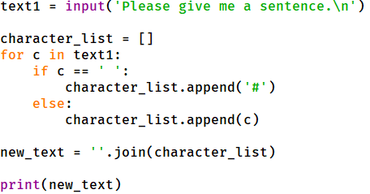
Question 1.1
Fill the blank place with missing code. The program will accept a string and change space to ‘#’ and print the result.

Slide 3
Question 1.2
Fill the blank place with missing code. The program will accept a string and change space to ‘#’ and print the result.

Slide 4
Question 1
Answer.

Slide 5
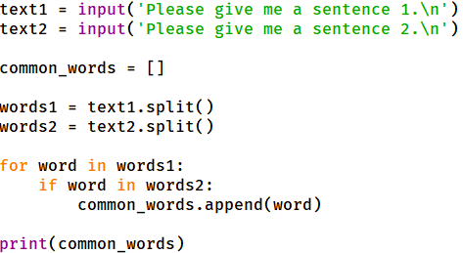
Question 2.1
Fill the blank place with missing code. The program will accept two strings, then find and print common words.

Slide 6
Question 2.1
Fill the blank place with missing code. The program will accept two strings, then find and print common words.

Slide 7
Question 2
answer.

Slide 8
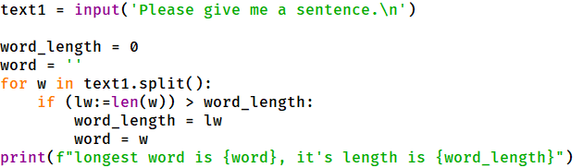
Question 3.1
Fill the blank place with missing code. The program will accept one string, and find the longest word.

Slide 9
Question 2.1
Fill the blank place with missing code. The program will accept two strings, then find and print common words.

Slide 10
Question 3
answer.

